Slide 1
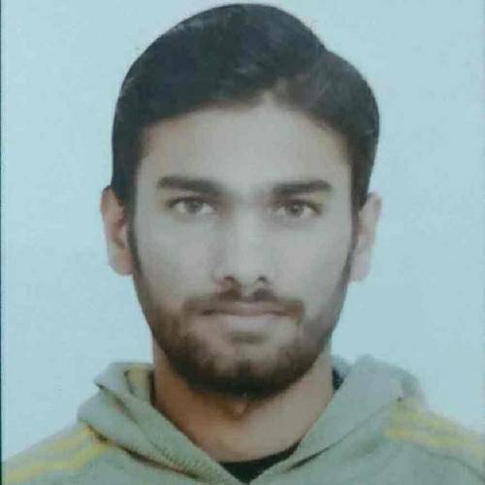

Mohammad Amir Raza
Analyst/Software Engineer
Master of Computer Application :2017-2020
Mumbai
Skills C# ASP. NET Framework ADO. NET ASP. NET Core MVC Rest API Flutter Azure Database SQL database – MySQL PostgreSQL Web Technologies HTML5 CSS3 JavaScript/TypeScript AddOns GitHub Postman Tools Visual Studio 2019 Visual Studio code Swagger Android Studio Additional Details Leadership Quick Learner Team management
Mohammad.b.raza@capgemini.com
+91 6387990663
A4
A team player with good communication skill always ready to work for the enrichment of knowledge.
Good problem solver and Logical thinker.
Ready to learn new technologies and implement them to further improve my knowledge.
Proficient Asp. Net Core developer with working knowledge on Asp. Net Core MVC.
Implemented Rest API and React in case study and up skilling this knowledge continuously.
Has working knowledge on Mobile App Development using Google Flutter framework on an intermediate level.
Online Event Management System
Completed end to end case study of Online Event Management System along with JWT authentication, Swagger and Rest API using Asp. Net Core MVC, Microsoft SQL and Bootstrap used for user interface.
AZ – 900 Microsoft Azure Fundamentals, AZ-104, AZ-204, AZ-400, Az-500, and Az-305 certified.
Learning AZ- 900 Microsoft Azure Fundamentals from Capgemini Degreed platform.
Participated at Smart India Hackathon Grand Finale – 2019 Organized by Indian Government
In Smart India Hackathon, I worked on Task Management System for Goonj NGO using Asp. Net and Microsoft SQL.

